Slide 1
Medicare Expense
Expenditure and Cost Analysis

Slide 2
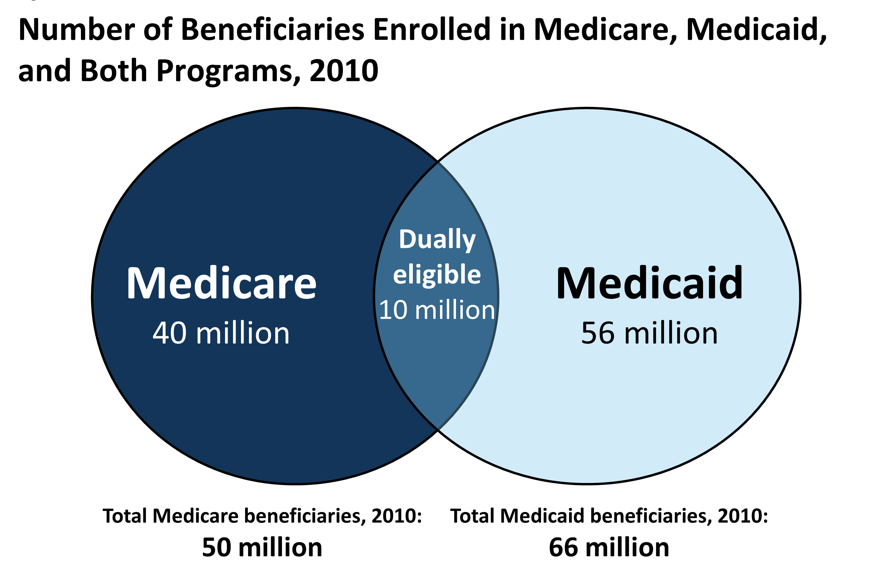
Medicare
Established in 1965
10 Million people were eligible over the age of 65
The government realized less then 50% had any kind of insurance
Average cost of deductible then was $60

Slide 3

Why did we select it?
The government collects and makes public all the expenses related to Medicare for every year. This data can be analyzed which will help in reducing the cost to exchequer.

Slide 4

Methods and Work
Data Cleaning, Data Minning
Creation of Data Warehouse
Error Handling, Validation and SCD
Analysis of the Data

Slide 5
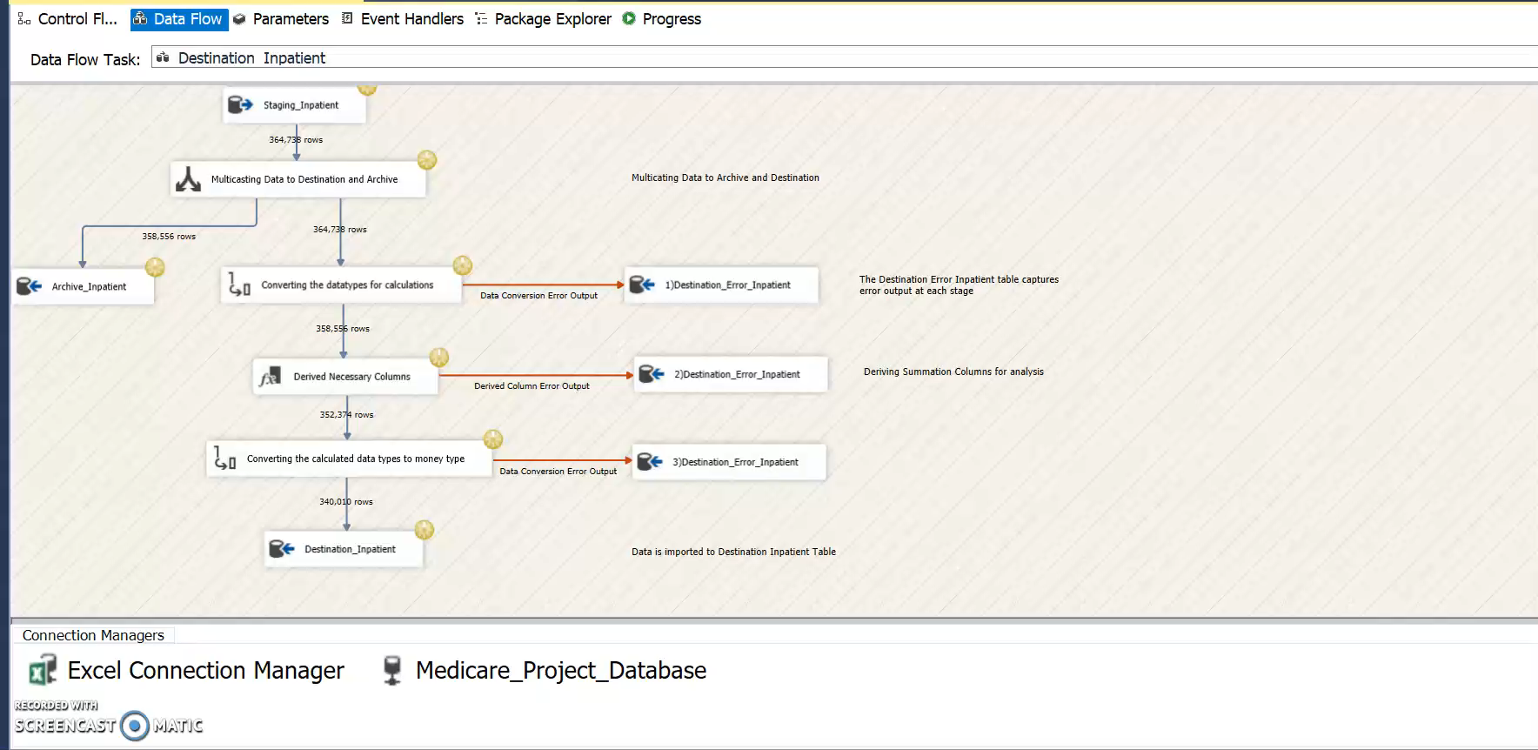
Loading Data

Slide 6
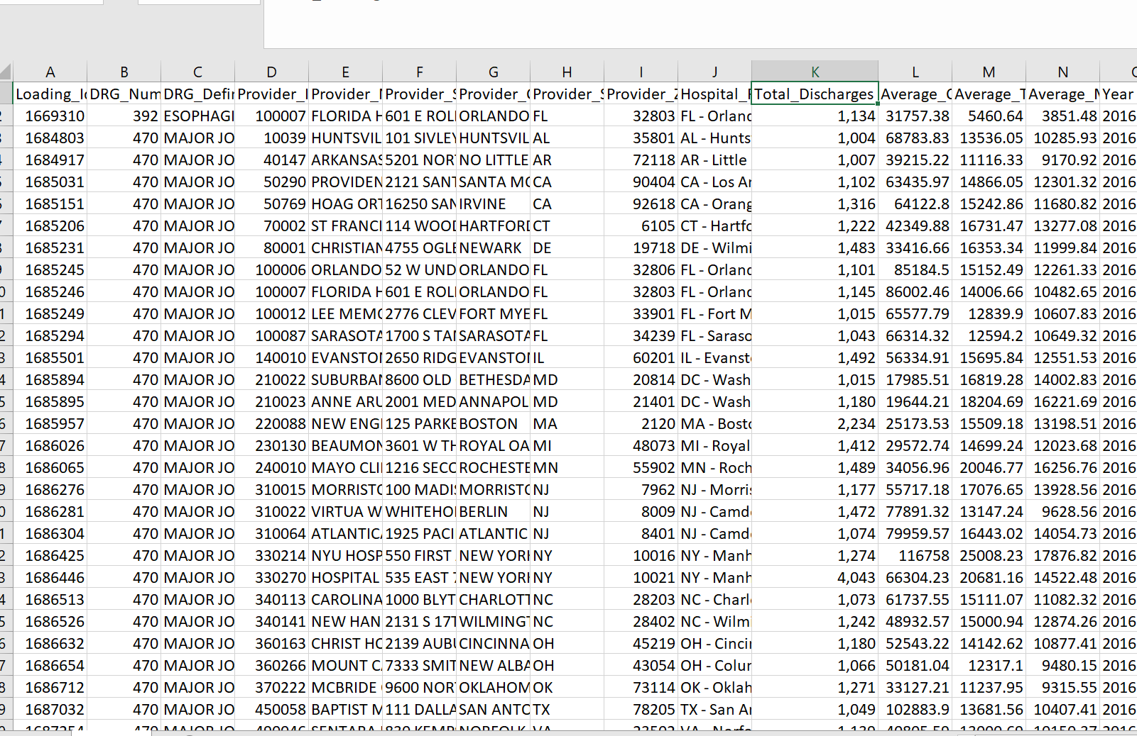
Commas

Slide 7
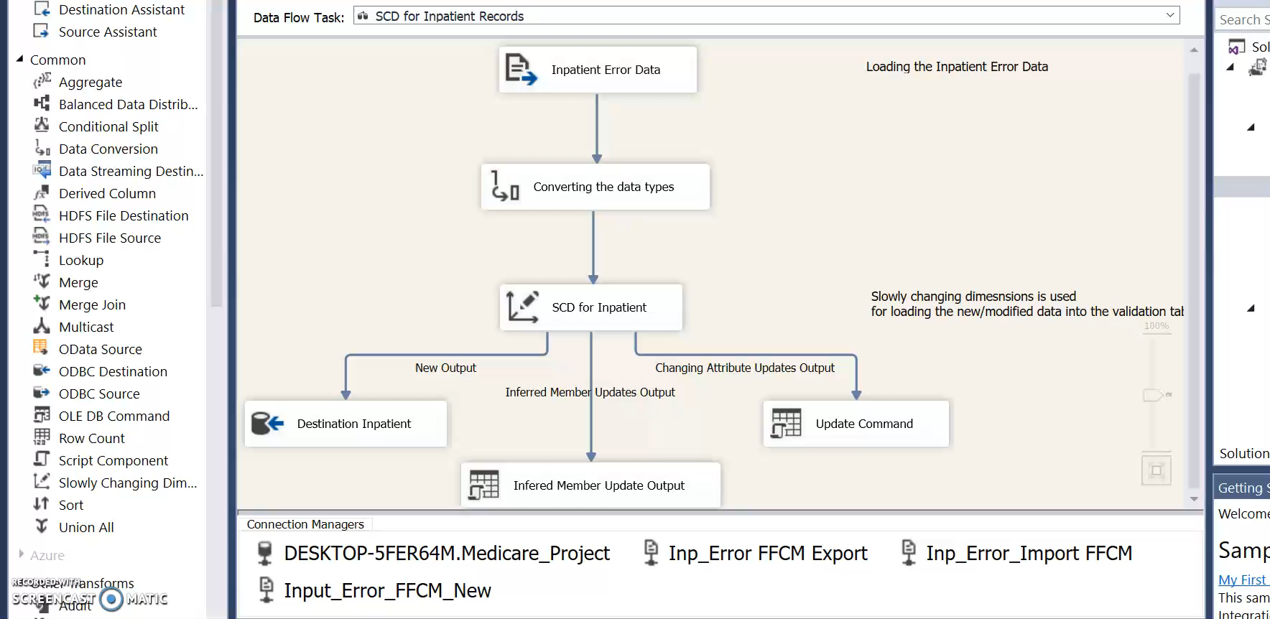
Loading SCD

Slide 8
Analysis

Slide 9
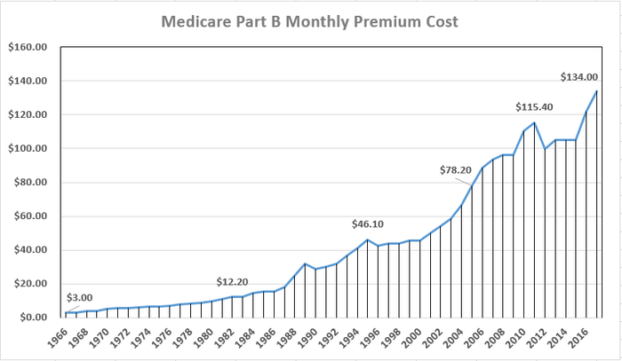
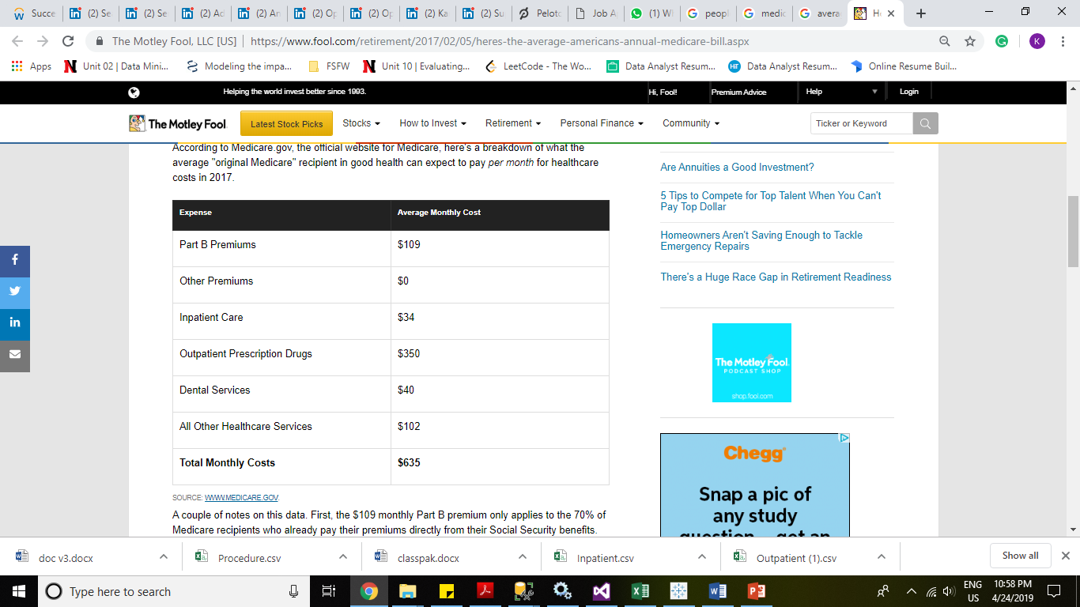
Increase in Cost per patient

Slide 10

But cost leads to R&D and Higher Life Expectancy Or is it so?

Slide 11
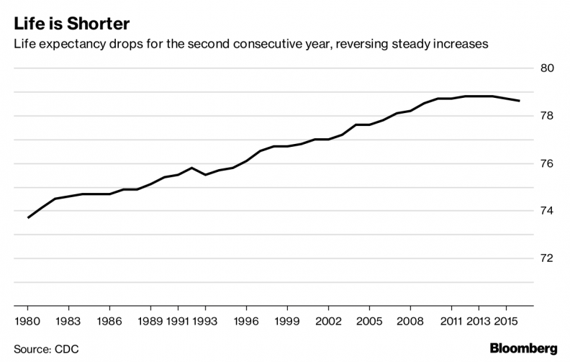
Falling Life Expectancy

Slide 12

Reasons

Slide 13
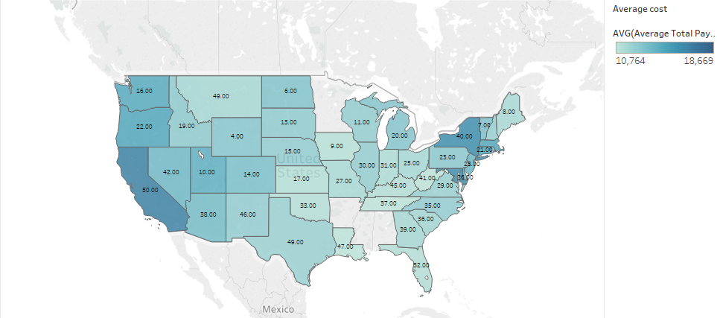
Cost and Education

Slide 14
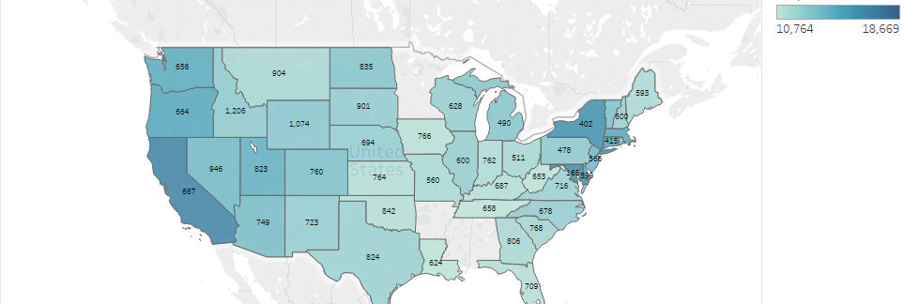
Specialist Physician Per Population Vs Cost

Slide 15
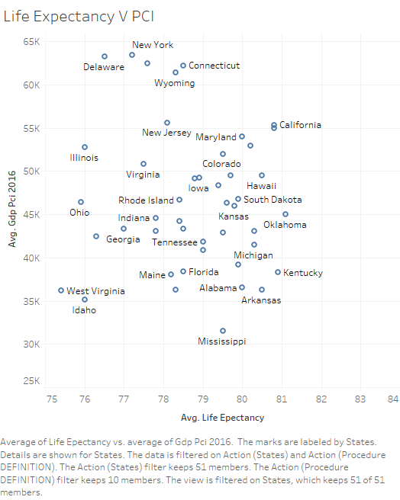
Income improves Life!

Slide 16
Dynamic Analysis

Slide 17
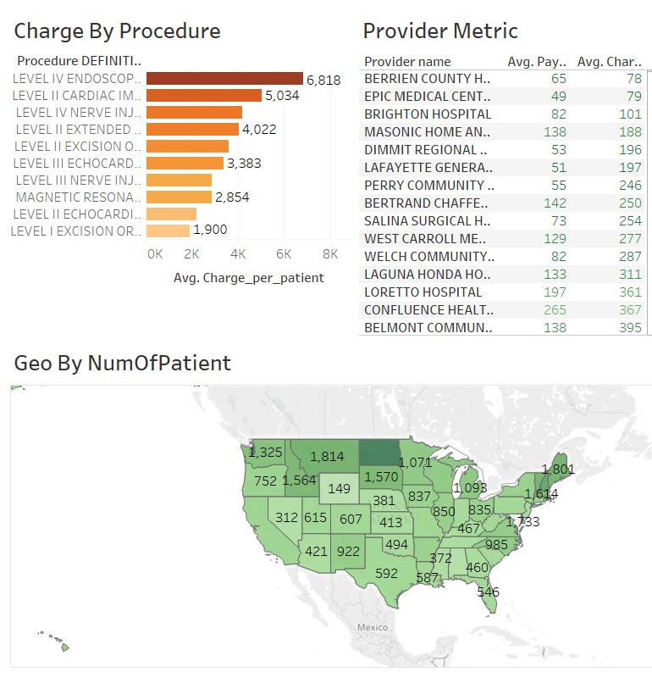
Which Provider Cost us the least?
https://public.tableau.com/profile/rohit.appandaraju#!/vizhome/MedicareProject_15563037766720/WhichProviderCosttheleast

Slide 18
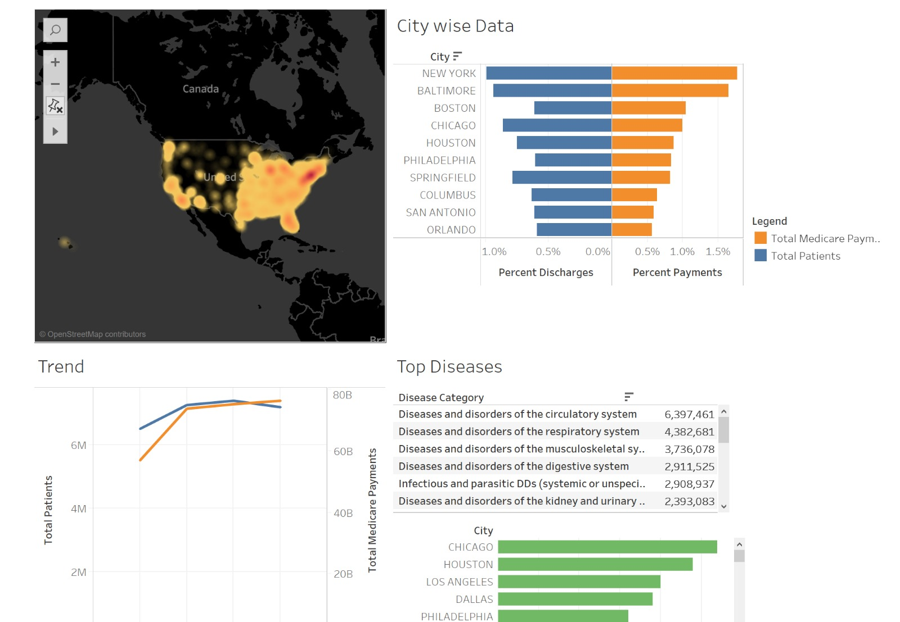
Region Wise Analysis
https://public.tableau.com/profile/nadeem2788#!/vizhome/RegionWiseDiseaseAnalysis/Dashboard1?publish=yes

Slide 19
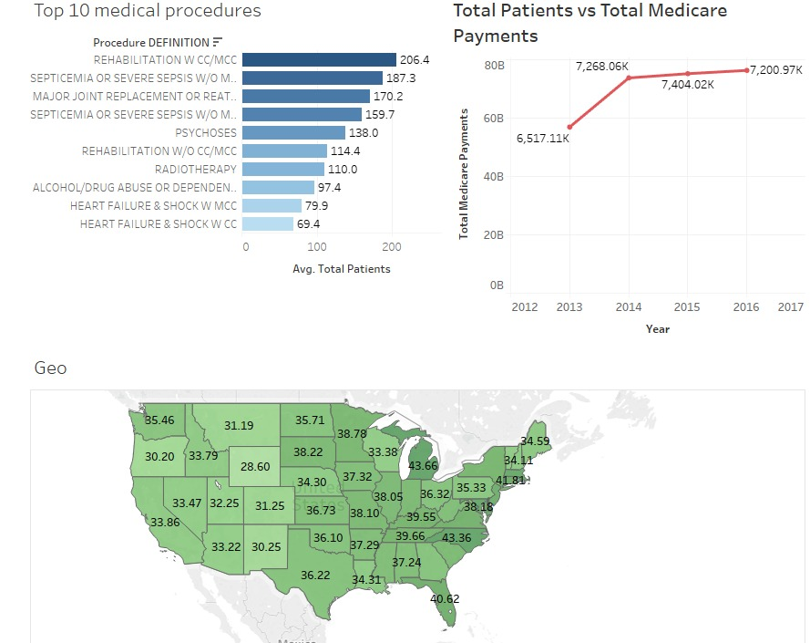
Top 10 Medical Procedures vs Trends
https://public.tableau.com/profile/rohit.chandrasekhar#!/vizhome/dwbivisualization/Dashboard1?publish=yes

Slide 20
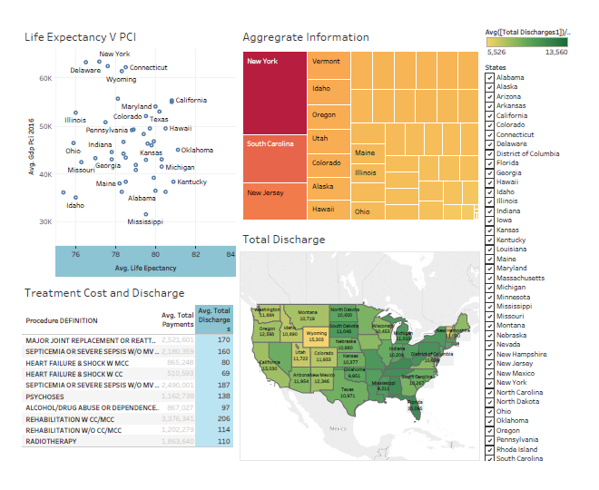
How is PCI, Number of Hospitals, Beds and Cost of treatment impacting Life expectancy and patient visits
https://public.tableau.com/profile/karthik.ranganathan#!/vizhome/PCIvsTreatmentCostvsDischarge/PCIvsTreatmentvsDischarge

Slide 21

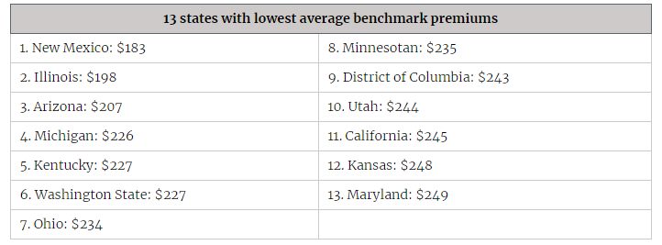
Correlation

Slide 22

Reasons for some states having cheaper healthcare and premium cost
State involvement in marketplaces – ACA implementation
Medicaid Expansion – Less Brunt to private insurance holders
Competition from CO-OPs
Combined risk pools – Group premiums and Indiviual Premiums

Slide 23

Conclusions
The problem is complex
States have to implement or take points from ACA in order to reduce overall premiums as shown by 13 successful states
Medicare has become expensive regardless of the subsidy, this can be gotten rid by eliminating Medicare and subsidizing health insurance for people when they avail private insurances, thus increasing competition in the market and reducing the overall cost of insurance

Slide 24

Take Away
The devil is in the details
Could have looked into more data which included patient age, individual cost and other reports
Every situation in unique and the categorization of data has to be more complex
Generalized lot of data to simplify the visualization
By toning the data down to specific hospital or treatment which have higher accuracy of cost to a larger scale, we can suggest detailed plans to reduce costs
Additional Years could give us information on various trends and accurate insights

